Slide 1

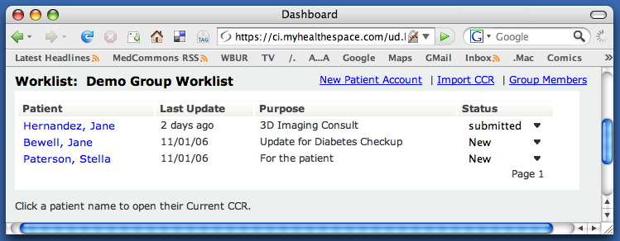

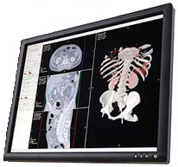
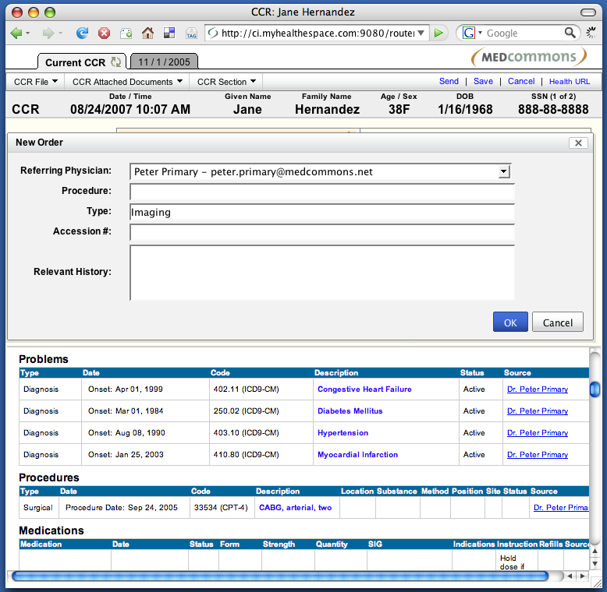
Federated Teleradiology
Off-site Services Options
Backup
Other Federated Health URL
Radiology Order Enhancements
⬥
◆

Referring
Physician
Order Support
Worklist
DICOM
HL7 Orders
CCR DICOM
Status
Select
Patient
❖
DDL
History
DDL
HL7
Reports
Triage,
Compression
Report
Images, Priors

Context
Manager
Report,
Processed Images
Report
Images
Patient List

Set Patient
OPTIONAL APPLIANCE
The federated design of Health URLs means that access to one appliance is equivalent to any other. A separate appliance at the imaging hospital can support local worklists, backup, and serve as an image-enabled portal to the practice.
IMAGING
HOSPITAL
WWW
FEDERATION
INTERPRETING
HOSPITAL
⧫
OsiriX or DICOM
Workstation
FEDERATED TELERADIOLOGY - FEATURES
◆ Clinical order support from interpreting hospital
PACS, RIS and EHR are optional
Each hospital controls their own worklist
DDL context manager pre-fetches images
Context manager launches workstation and Health URL
 Image streaming has priority over backup
Health URL
Notes:
Federated Teleradiology is included with every Health URL

Slide 2

Consent
HIPAA Activity Log
Share with OpenID
HIPAA Records Request
Group Access
Individual Access
PIN Access
Backup
Shadow Appliance
Individual HealthURL
Amazon S3 Interface
Workflow
Activity Log
Group Patient List
Search for Patient
Patient Status
Episodes of Care
Practice
Player
Laboratory
Hospital
Trainer
Notification
Email
RSS / ATOM
SMS
Facebook
Web Browser
IE7
Firefox
Safari
iPhone
Imaging
Center
Physician
Hospital
Protocol Converters
DICOM PACS
DICOM CD / DVD
FAX
Federated Security
Single Sign-On
OpenID
OAuth
Trusted IDP Whitelist
Two-factor Authentication
Web Services
CCR
DICOM, PDF, JPEG, PNG Attachments
Consent
Activity Log
Global HealthURL Redirect
Global Tracking Number Redirect

Slide 3
Users
Physicians
HIM Administrators
MedCommons
HealthURL Appliance
Web Components
Login
Group Worklist
Current Patient
HIPAA Authorizations
Admin Console
RSS
CCR
CCR Forms
CCR, PDF, DICOM
XACML Authorizations
Current CCR Merge
Web Services - Standard
MedCommons Routing
Email Notifications
SMS Messages
Web Services - Options
Amazon S3 Backup
MedCommons Hosting
Fax Capture
Credit Card Processing
USPS Letters
PHR Concierge
Thawte Certificates
Web Services - Federation
Identity Provider
Practice Management Systems
Web Browser
OsiriX W/S
Clinical Data Repository
HL7
SQL
MDL
DICOM
DDL
PACS
PHR Accounts
Document M’gt
Web Site
Web Browsers
Employee / User Directory
Web ID Services (opt)
Web Services Federations
Firewall
Practice
LAN
DMZ

Slide 4
Remote Document Editing API
link

Slide 5

Hospital
with IHE std EHR
without EHR
Solo or Group Practice
with EHR
without EHR
Day surgery
Walk-in clinic
Imaging Facility
with PACS
without PACS
IHE Data Liberator Appliance
Private Health Records Service
DICOM Data Liberator Appliance
www
Web Browsers
IE
Firefox
more…
Web 2.0
Wiki
Blog
RSS
Web Portals
Hospital
Health Plan
Employer
Publisher
Cell Phones
J2ME
SMS
Diagnostic Workstations
OsiriX (Free, Open Source)
Cardiology
Radiology

Slide 6
Services
Facebook
Web Services
Amazon
Web Services
Other Public
Web Services and App’s
MedCommons HealthURL
Appliance Services
HTTP
Direct Registration
ID Federation List
App Federation List
Local Group Authorization
Payment Authorization
Notification
Social Networking
Public HealthURL
HIPAA Consents & Logs
Direct Online Access
Secure Web Services
Client Installed Applications
Bar-Coded Fax to PDF
Online Storage
Identity Management
Verisign
OpenID
Facebook
OAuth
HTTP
Amazon Pay
DevPay
Social Networking
Email, RSS, ATOM
Facebook
OAuth
CCR Commons
HTTP
OAuth, OpenID, ATOM
Content Management
Amazon EC2
AWS
Amazon EC2
AWS
DICOM U/D, CCR Editor
HTTP
Fax.com
HTTP
Object Management
Amazon S3
AWS

Slide 7






MedCommons Global Services
Health Applications Categories
Application Examples
Concierge Medical Records Services
Universal Patient ID Service
Software License Management
Physician and Practice Rebate Services
HealthURL Redirection Service
CCR Commons Moderation
Application Signature Registry
Branded Social Networking Mash-ups
Social Networks with Custom PHR UI
HIPAA “Covered Entity” Appliance
MedCommons DDL
https://healthurl.medcommons.net
https://apps.medcommons.net
http://www.ccrcommons.com
http://healthurl.ccrcommons.com
HealthURL Appliance Federations
Interoperable Web PHR Services
Home Care Device Drivers and Apps
Pending

Slide 8
Facebook User
Facebook Application
MedCommons Appliance
Amazon DevPay
Finds MedCommons FB Application
Click Add
Application
Home Page
Click Create Account
Privacy Page
Open Amazon Page with Product Number
Login Page
Enter Amazon Email and Password
Pricing Page
Click Purchase
Confirmation Page
Add User to Application DB
Client Token and Product Token
Add User to Appliance DB
Privacy Page
Display HealthURL Icon
Click HealthURL Icon
CCR Editor,
PDF Upload,
Add DICOM,
Etc…
Sequence 1
Facebook User Creates New HealthURL Account
Home Page
Invite
“Friends”
Care Team Page

Slide 9


User
MedCommons Appliance
Identity Provider
Fax to Web Service
Click HealthURL
Login Challenge
OpenID
Login Page
Name, Password
Consent Page
OpenID
Coded Fax Form
Print
Print Preview
Add Documents to Fax Cover Sheet
Convert Fax to PDF, decode 2D bar code and POST to Web
HealthURL
Display
CCR Viewer
Confirm
Sequence 2
Add Document as PDF to HealthURL

Slide 10
Team
Trainer
Web Application
MedCommons Appliance
Identity Provider
Login
Home Page
Select
Player Page
Enter Doctor’s
OpenID
Add Doctor’s OpenID to HealthURL ACL
OAuth Tokens and Access Attributes
Consent Page
Doctor
Click HealthURL
Login Challenge
OpenID
Login Page
Two-factor Authentication
OpenID
CCR, PDF, DICOM Viewer,
Etc…
Sequence 3
Share HealthURL with Independent MD

Slide 11

User
DICOM CT, MR,
PACS or Workstation
MedCommons Appliance
DDL Client Application
DICOM Service
DICOM Cache
DICOM
(a) Send
(b) Load DICOM CD
Login
Patient List
Authorize
Select Patient
DICOM to CCR
Add DICOM
Match
Patient
Status Page
DICOM over HTTP
Status Pop-up
QC
CCR, DICOM Viewer
(c) Download DICOM
CCR, DICOM Viewer
DICOM over HTTP
DICOM Cache
DICOM
Receive
Sequence 4
LAN to Web Gateway for DICOM Imaging

Slide 13
Practice
Web Server
Case 1 - A practice with electronic health records that decides to host standard health records for some or all of their patients.
EMR
HealthURL
Service
Firewall
LAN DMZ
Case 2 - A practice with paper health records that decides to host standard health records for their patients.
Web Server
HealthURL
Service
Case 3 - A practice with electronic health records and a proprietary patient portal.
EMR
Web Server
Hosted
HealthURL
Service
Case 4 - A RHIO or independent service hosting standard health records.
Internet

Slide 14
Authorization Flow
User Login Authorization Form (Small Privacy Gadget) External Preview Account Import
Login Account ID is Displayed
Enter Grantee
Select Grantor (Group, Patient, Guardian)
Select Label (default = Authorize)
Enter Notification (opt)
Enter PIN (opt)
Preview Print or Display
Sign as Grantor
Fax, Scan, Acrobat Pro Confirm PDF
Confirm User Password
Save PDF in Account
Update XACML
Grantee name links to signed and countersigned PDF saved in the Account.
XACML may be in database or Account. Account Access Authorization List is dynamically created when Privacy Gadget is expanded.
Account Access Authorization List (Expanded Privacy Gadget) X
Grantee Grantor Access Privilege invite…
(As entered on Authorization Form) (Link shows both Grantor as entered (Default is RW, could be (could be dropdown
on Form and User who Confirmed optionally set on form as well) with Confirm User PW
Account Import as Countersign) challenge)
Transplants Group Transplants Group RW change…
Jane Hernandez Transplants Group Verified Patient change…
Doctor Primary Jane Hernandez RW change…
Laboratory B Transplants Group W change…
randomdoc@aol.com Jane Hernandez PIN 23576 change…

Slide 15


Health URL Appliance
IMAGING
HOSPITAL or CLINIC
EHR
PACS
BROWSER
etc…
CONSULTANT
MedCommons
Health URL
Appliance
Internet
HOSPITAL
PATIENT

Slide 16
Federated Appliances
MedCommons
Health URL
Appliance
FEDERATED
TRUST
AGREMENTS
BANK as
IDENTITY PROVIDER
SERVICE PROVIDER
CONSULTANT
Internet
PATIENT
SERVICE PROVIDER

Slide 17
Federation of Health Records Web Services
FEDERATED
IDENTITY PROVIDER
MAJOR HOSPITAL
PAKISTAN
MAJOR HOSPITAL
INDIA
CONSULTANT
(anywhere)
HOSPITAL
NORTH
HOSPITAL
NORTH
Internet
HOSPITAL
SOUTH
HOSPITAL
SOUTH
PATIENT ACCESS
(optional)
CLINIC
CLINIC
LEGEND
CLINIC
MedCommons Health Records Appliance
Web Browser or Web Services Client (anywhere)
Federated Trust Agreements (optional)
Independent Identity Provider (optional)
CLINIC
CLINIC
CLINIC

Slide 18
CCR PDF
TRANSPORT
DOCUMENTS
PRIVACY
MedCommons
Health URL
Appliance Standards
CXP
MTOM
SAML
XACML
IMAGES
DICOM JPEG

Slide 19
Patient-Centered Clinical Services
Service
Disease Management
P4P Registry
- Public Health
CCR
Problems
Medications
Vital Signs
- Annotations
CCR
Vital Signs
Weight
Chemistry
Patient
Annotations
Home
Home Health Hub
- Personal Health Record
CCR
Report PDF
Prompts
Questions
Health URL
CCR
Medication Schedule
Test Schedule
- Prompts
- Questions
CCR
- Vital Signs
Patient
Annotations
- Report PDF
CCR
- Orders
Problems
- Medications
Test Schedule
Clinician
Physician
Consultant
Home Health Nurse

Slide 20
Federated Clinical Services
Service
Disease Management
P4P Registry
- Public Health
Home Clients
Secure Home Health Hub
Cell Phone
- Web Browser
Health URL
Service
MedCommons
Health URL Discovery
  By Account ID
  By Tracking Number
Software
  Health URL Server Appliance
  DICOM Gateway
  HL7 Gateway
Support
Optional Federated
Identity Provider
Single Sign-On To Health URL
  Hospital’s LDAP
  Cellular Carrier
  Bank
Clinician
Web Browser
HL7 Gateway
EHR Web Portal

Slide 21
Patient-Centered…
Anyone can host a patient’s Health URL. Standard Web services will discover it and enable single sign-on by authorized users.
Service
Disease Management
P4P Registry
- Public Health
Home Clients
Secure Home Health Hub
Cell Phone
- Web Browser
Health URL
Service
Internet
MedCommons
Health URL Discovery
  By Account ID
  By Tracking Number
Software
  Health URL Server Appliance
  DICOM Gateway
  HL7 Gateway
Support
Health URL
Service
Optional Federated
Identity Provider
Single Sign-On To Health URL
  Hospital’s LDAP
  Cellular Carrier
  Bank
Clinician
Web Browser
HL7 Gateway
EHR Web Portal

Slide 22
Patient-Centered
Health Information Exchange (HIE)
 | Paper / Fax | EHR | PHR | Health URL HIE
Anyone / Anywhere |  |  |  | 
Patient-Centered |  |  |  | 
CCR, PDF, DICOM Std’s |  |  |  | 
Diagnostic Imaging |  |  |  | 
Home Health Monitoring |  |  |  | 
Practice Management |  | 

Slide 23
Products
Health URL Appliance
DDL - DICOM Data Liberator
Diagnostic Workstation Plugin for OsiriX
MDL - MedCommons Data Liberator for IHE
Single Sign-On Interfaces

Slide 24
Health URL Applications
HIPAA Records Requests
Internet Consultations
Tertiary Care Referrals
Outcomes Registries and P4P
Retail Clinics
Radiology Services
Home Health Care Agencies
Disease Management Services
Sports Injury Response

Slide 25
Social Network Medicine Paradigm
From: Clinical Informatics
To: Social Network Medicine
Order / Report sets and Encounters
Aggregate Encounters within institutions to Medical Records
Aggregate Medical Records to Clinical Data Repositories
Anonymize
Aggregate across institutions to Publish and Compete
Order / Report sets and Encounters
Aggregate Encounters across institutions to Episodes of Care
Aggregate Episodes of Care over time to a Patient
Physician and Patient Control
Aggregate over Patients to Social Network Medicine

Slide 26
HealthURL Account
A Networked Private Structured Health Portfolio
Encounters
  Data, Doc’s, Observations…
Episodes of Care
  Merged encounters across institutions and over time
Consents
  Personal and voluntary authorization to participate in Social BioNetworks
Web 2.0 Interfaces
  Identity (pseudonimity)
  Single sign-on (for physicians and more…)
  Documents (semantics, signatures, standards…)
  Collaboration (groups, instant messaging…)

Slide 27
Web
Off-site Backup and Federated HealthURL
Options
ROE Order Enhancement Option
Clinical Order
Support
DICOM
HL7 ORDERS
CCR DICOM
Hospital
MedCommons
APPLIANCE
MGH
MedCommons
APPLIANCE
Select
Patient
LAN
DDL
DDL
HL7
Reports
Report
Status
Triage
Health URLs
MGH Worklist
Context Manager
Referring Physician
Report
Images
Patient List
Set Patient
Cache
Flow
Control
Commands
Workstation
Server(s)
Workstation
Client
Federated Teleradiology
MedCommons
August 13, 2007
Image Streaming
Volume Render
Compression
UI
A PACS or RIS at the hospital are optional
DDL Triage agent creates HealthURLs for radiology studies
Hospital Appliance fetches priors from HealthURL to cache
MGH Worklist is kept up-to-date with order status
Modalities or PACS send DICOM to DDL automatically
Hospital Appliance stores DICOM in Cache as it arrives
Radiologist Selects a case from the MGH Worklist
DDL Context Manager launches workstation and browser
Workstation Client commands images for display
Workstation Server compresses images and streams them
Hospital Appliance backs off sending for workstation priority
Radiologist types into browser or dictates to HealthURL
DDL forwards Reports to hospital EHR via HL7
Report
Web
Browser
HealthURL

Slide 28
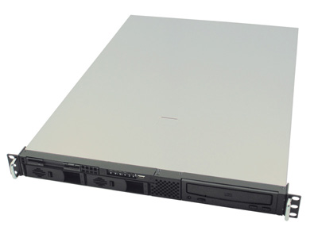
MedCommons Health URL Appliance Services and Interfaces
Consent
HIPAA Records Request
Group Access
Individual Access
PIN Access
Backup
Entire Appliance
Individual Account
Amazon S3 Interface
Web Browser
IE6 and 7
Firefox
Safari
iPhone
Workflow
Group Patient List
Search for Patient
Patient Status
MedCommons
Health URL (+)
Appliance
Web Services
Health URL (+) CCRs
DICOM, PDF, JPEG, PNG Attachments
Current Patient
Global Health URL Redirect
Global Tracking Number Redirect
Protocol Converters
DICOM
DICOM CD / DVD
Personal Context Manager
HL7
FAX
Digital Signatures
W3 XML Standard
PKI Certificates
Federated Identity
Single Sign-On
OpenID
Liberty Alliance Option
Notification
Email
RSS

Slide 29


Off-site Services Options
Backup
Other Federated Health URL
Radiology Order Enhancements
Referring
Physician
Order Support
MedCommons
Health URL (+)
Appliance
Worklist
DICOM
HL7 Orders
CCR DICOM
Status
Select
Patient
DDL
MedCommons
Health URL (+)
Appliance
History
DDL
HL7
Reports
Triage
Report
Report
Context
Manager
Report
Images
Patient List
Set Patient
Image Cache
Flow
Control
Commands
Image Streaming
Workstation Server
Volume Render
Compression
Thin Client
Workstation
FEDERATED TELERADIOLOGY
August 2007
IMAGING
HOSPITAL
WWW
FEDERATION
INTERPRETING
HOSPITAL
Health URL (+)

Slide 30
Off-site Services Options
Backup
Other Federated Health URL
Radiology Order Enhancements
Referring
Physician
Order Support
MedCommons
Health URL (+)
Appliance
Worklist
DICOM
HL7 Orders
CCR DICOM
Status
Select
Patient
DDL
MedCommons
Health URL (+)
Appliance
History
DDL
HL7
Reports
Triage
Report
Report
Context
Manager
Report
Images
Patient List
Set Patient
Image Cache
Flow
Control
Commands
Image Streaming
Workstation Server
Volume Render
Compression
Thin Client
Workstation
FEDERATED TELERADIOLOGY
August 2007
IMAGING
HOSPITAL
WWW
FEDERATION
INTERPRETING
HOSPITAL
Health URL (+)

Slide 31
Off-site Services Options
Backup
Other Federated Health URL
Radiology Order Enhancements
⬥
◆

Referring
Physician
Order Support
MedCommons
Health URL (+)
Appliance
Worklist
DICOM
HL7 Orders
CCR DICOM
Status
Select
Patient
❖
DDL
MedCommons
Health URL (+)
Appliance
History
DDL
HL7
Reports
Triage
Report
Report

Context
Manager
Report
Images
Patient List
Set Patient
Image Cache

Flow
Control
Commands

Image Streaming
Workstation Server
Volume Render
Compression
Thin Client
Workstation
UNIQUE FEDERATED TELERADIOLOGY FEATURES
Clinical order support from interpreting hospital
PACS, RIS and EHR are optional
Each hospital controls their own worklist
Context manager launches C/S workstation and Health URL
Compressed image streaming for bandwidth efficiency
 Image streaming has priority over backup and Health URL
⧫
IMAGING
HOSPITAL
WWW
FEDERATION
INTERPRETING
HOSPITAL
Health URL (+)

Slide 32
Off-site Services Options
Backup
Other Federated Health URL
Radiology Order Enhancements
⬥
◆

Referring
Physician
Order Support
MedCommons
Health URL (+)
Appliance
Worklist
DICOM
HL7 Orders
CCR DICOM
Status
Select
Patient
❖
DDL
MedCommons
Health URL (+)
Appliance
History
DDL
HL7
Reports
Triage,
Compression
Report
Images, Priors

Context
Manager
Report,
Processed Images
Report
Images
Patient List

Set Patient
OPTIONAL APPLIANCE
The federated design of Health URLs means that access to one appliance is equivalent to any other. A separate appliance at the imaging hospital can support local worklists, backup, and serve as an image-enabled portal to the practice.
UNIQUE FEDERATED TELERADIOLOGY FEATURES
Clinical order support from interpreting hospital
PACS, RIS and EHR are optional
Each hospital controls their own worklist
DDL context manager pre-fetches images
Context manager launches workstation and Health URL
 Image streaming has priority over backup
OsiriX or DICOM
Workstation
⧫
IMAGING
HOSPITAL
WWW
FEDERATION
INTERPRETING
HOSPITAL
Health URL (+)

Slide 33
A MedCommons Health URL appliance enables any practice to host the “medical home” for any patient’s health record.
MedCommons
Health URL (+)
Appliance
Medical Home
Practice
Patient
Laboratory
Hospital
Caregiver
Imaging
Center
Caregiver
Hospital
Radiology Workstation
Health URL Principals
Anyone can host a patient’s Health URL
Others can be granted access as required
The patient can change hosts if they choose

Slide 34
Practice
Laboratory
MedCommons
Health URL (+)
Appliance
Caregiver
DDL
Context
Manager
Medical Home
Caregiver
Imaging
Center
Hospital
Hospital
DDL Context Manager
Enhances the provider’s use of Web worklists
Launches local applications
Bridges legacy protocols for orders, images and reports
Radiology Workstation

Slide 35
Where is your medical home*?
Business Model | HIPAA Covered Entity | HIPAA Business Associate | Branded Medical Record Bank | Social Network
Example | Medical Center | Service Provider to a Medical Center | Microsoft HV Google Health | Facebook Group iPhone App
HI Exchange E-visits Medication Recon.
Records Shared or Deleted under Patient Control
Integrated Diagnostic Imaging |  |  | Single Sign-On to HealthURL Partners
Revenue Model | Loyalty Records Fees eVisits | Records Fees Concierge Services | ? | Advertising Non profit Subscription
HealthURL License | Dedicated MedCommons Appliance | Shared MedCommons Appliance | Open Standards Compatible Web Site | Public MedCommons Web Site
* A person’s medical home is the focus of care coordination among multiple primary care, specialty, family and social supports.

